Slide 1
Capstone Project – Italian Restaurant in Berlin

Slide 2
INTRODUCTION
Background:
In this project we will try to find an optimal location for a restaurant. Specifically, this report will be targeted to stakeholders interested in opening an Italian restaurant in Berlin, Germany.
Problem:
Since there are lots of restaurants in Berlin we will try to detect locations that are not already crowded with restaurants
Interest:
We are also particularly interested in areas with no Italian restaurants in vicinity. We would also prefer locations as close to city center as possible, assuming that first two conditions are met

Slide 3
DATA ACQUISITION And CLEANING
Data:
Based on definition of our problem, factors that will influence our decission are:
number of existing restaurants in the neighborhood (any type of restaurant)
number of and distance to Italian restaurants in the neighborhood, if any
distance of neighborhood from city center
Following data sources will be needed to extract/generate the required information:
centers of candidate areas will be generated algorithmically and approximate addresses of centers of those areas will be obtained using Google Maps API reverse geocoding
number of restaurants and their type and location in every neighborhood will be obtained using Foursquare API
coordinate of Berlin center will be obtained using Google Maps API geocoding of well known Berlin location (Alexanderplatz)

Slide 4
METHODOLOGY
Detect areas of Berlin that have low restaurant density, particularly those with low number of Italian restaurants. We will limit our analysis to area ~6km around city center
In first step we have collected the required data: location and type (category) of every restaurant within 6km from Berlin center (Alexanderplatz). We have also identified Italian restaurants (according to Foursquare categorization).
Second step in our analysis will be calculation and exploration of 'restaurant density' across different areas of Berlin - we will use heatmaps to identify a few promising areas close to center with low number of restaurants in general (and no Italian restaurants in vicinity) and focus our attention on those areas
In third and final step we will focus on most promising areas and within those create clusters of locations that meet some basic requirements established in discussion with stakeholders: we will take into consideration locations with no more than two restaurants in radius of 250 meters, and we want locations without Italian restaurants in radius of 400 meters
We will present map of all such locations but also create clusters (using k-means clustering) of those locations to identify general zones / neighborhoods / addresses which should be a starting point for final 'street level' exploration and search for optimal venue location by stakeholders

Slide 5
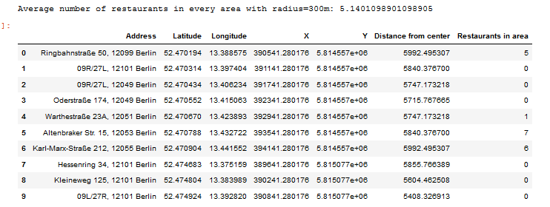
Exploratory Data Analysis
Let's perform some basic explanatory data analysis and derive some additional info from our raw data. First let's count the number of restaurants in every area candidate.

Slide 6
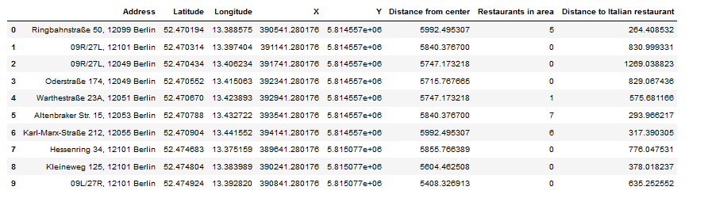
Analysis
OK, now let's calculate the distance to nearest Italian restaurant from every area candidate center (not only those within 300m - we want distance to closest one, regardless of how distant it is).

Slide 7
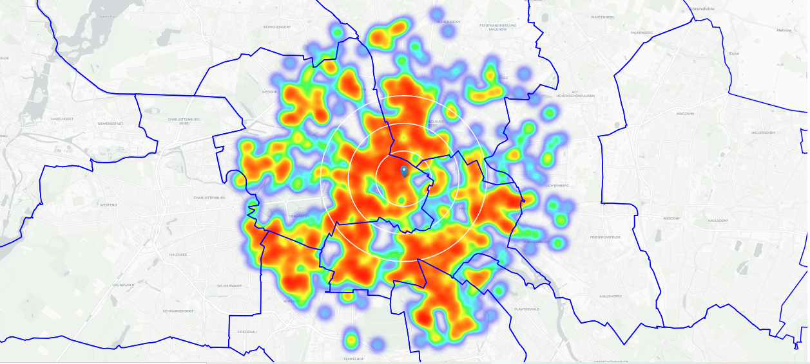
Analysis
on average Italian restaurant can be found within ~500m from every area center candidate. That's fairly close, so we need to filter our areas carefully!
Let's crete a map showing heatmap / density of restaurants and try to extract some meaningfull info from that. Also, let's show borders of Berlin boroughs on our map and a few circles indicating distance of 1km, 2km and 3km from Alexanderplatz

Slide 8
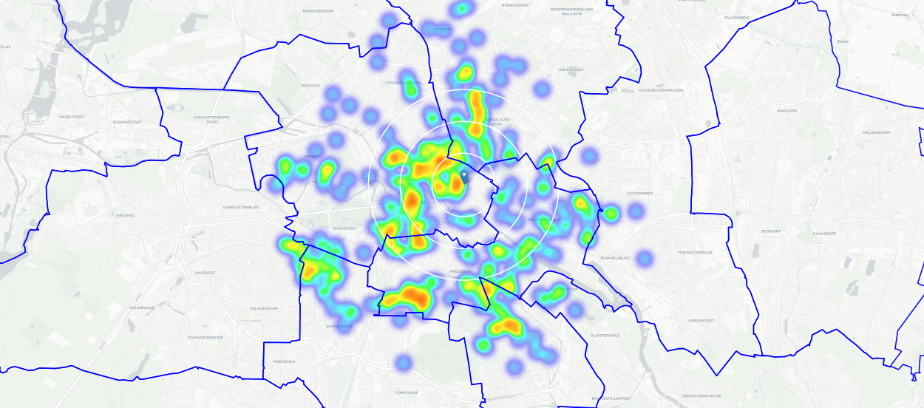
Analysis
Looks like a few pockets of low restaurant density closest to city center can be found south, south-east and east from Alexanderplatz.
Let's create another heatmap map showing heatmap/density of Italian restaurants only.

Slide 9
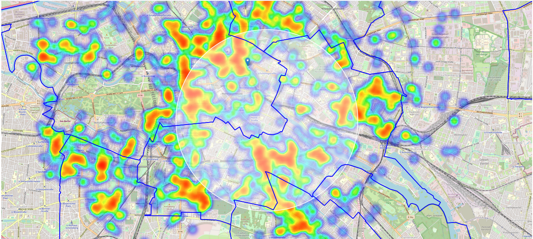
Analysis
Let's define new, more narrow region of interest, which will include low-restaurant-count parts of Kreuzberg and Friedrichshain closest to Alexanderplatz

Slide 10
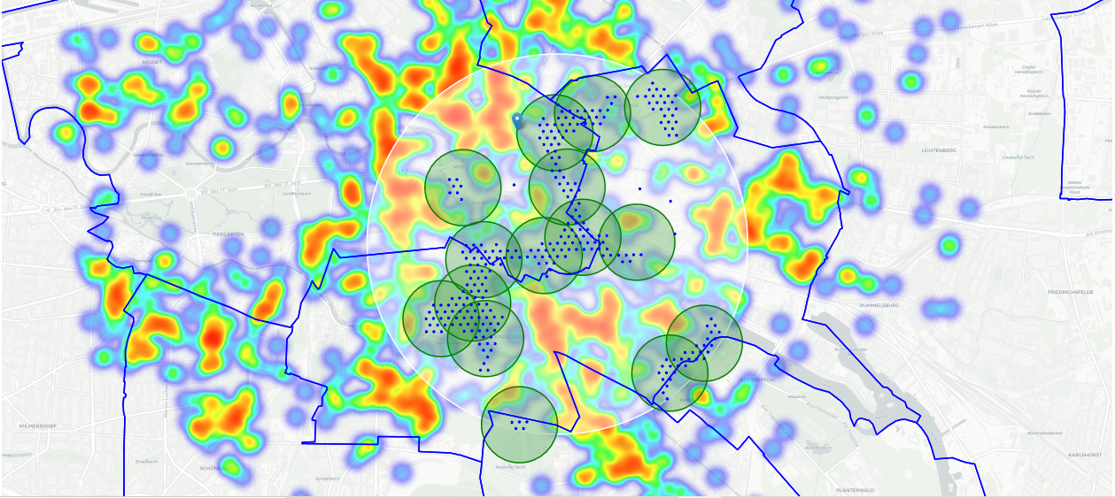
Analysis
we're interested only in locations with no more than two restaurants in radius of 250 meters, and no Italian restaurants in radius of 400 meters.
Looking good. We now have a bunch of locations fairly close to Alexanderplatz (mostly in Kreuzberg, Friedrichshain and south-east corner of Mitte boroughs), and we know that each of those locations has no more than two restaurants in radius of 250m, and no Italian restaurant closer than 400m. Any of those locations is a potential candidate for a new Italian restaurant, at least based on nearby competition

Slide 11
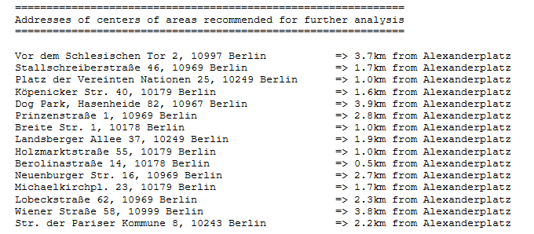
Analysis
This concludes our analysis. We have created 15 addresses representing centers of zones containing locations with low number of restaurants and no Italian restaurants nearby, all zones being fairly close to city center (all less than 4km from Alexanderplazt, and about half of those less than 2km from Alexanderplatz).
Although zones are shown on map with a radius of ~500 meters (green circles), their shape is actually very irregular and their centers/addresses should be considered only as a starting point for exploring area neighborhoods in search for potential restaurant locations.
Most of the zones are located in Kreuzberg and Friedrichshain boroughs, which we have identified as interesting due to being popular with tourists, fairly close to city center and well
connected by public transport

Slide 12
Results and Discussion
Our analysis shows that although there is a great number of restaurants in Berlin (~2000 in our initial area of interest which was 12x12km around Alexanderplatz), there are pockets of low restaurant density fairly close to city center
Highest concentration of restaurants was detected north and west from Alexanderplatz, so we focused our attention to areas south, south-east and east, corresponding to boroughs Kreuzberg, Friedrichshain and south-east corner of central Mitte borough.
Another borough was identified as potentially interesting (Prenzlauer Berg, north-east from Alexanderplatz), but our attention was focused on Kreuzberg and Friedrichshain which offer a combination of popularity among tourists, closeness to city center, strong socio-economic dynamics and a number of pockets of low restaurant density.
Result of all this is 15 zones containing largest number of potential new restaurant locations based on number of and distance to existing venues - both restaurants in general and Italian restaurants particularly.
This, of course, does not imply that those zones are actually optimal locations for a new restaurant! Purpose of this analysis was to only provide info on areas close to Berlin center but not crowded with existing restaurants (particularly Italian) - it is entirely possible that there is a very good reason for small number of restaurants in any of those areas, reasons which would make them unsuitable for a new restaurant regardless of lack of competition in the area.

Slide 13
Conclusion
Purpose of this project was to identify Berlin areas close to center with low number of restaurants (particularly Italian restaurants) in order to aid stakeholders in narrowing down the search for optimal location for a new Italian restaurant.
. By calculating restaurant density distribution from Foursquare data we have first identified general boroughs that justify further analysis (Kreuzberg and Friedrichshain), and then generated extensive collection of locations which satisfy some basic requirements regarding existing nearby restaurants.
Clustering of those locations was then performed in order to create major zones of interest (containing greatest number of potential locations) and addresses of those zone centers were created to be used as starting points for final exploration by stakeholders.
Final decission on optimal restaurant location will be made by stakeholders based on specific characteristics of neighborhoods and locations in every recommended zone, taking into consideration additional factors like attractiveness of each location (proximity to park or water), levels of noise / proximity to major roads, real estate availability, prices, social and economic dynamics of every neighborhood etc.

